Slide 1
Inheritance
Inheritance can be defined as the process where one class acquires the properties (methods and fields) of another.
With the use of inheritance the information is made manageable in a hierarchical order.
The class which inherits the properties of other is known as subclass (derived class, child class) and the class whose properties are inherited is known as superclass (base class, parent class).

Slide 2
Advantages of inheritance
When a class inherits from another class, there are three benefits:
(1) You can reuse the methods and data of the existing class
(2) You can extend the existing class by adding new data and new methods
(3) You can modify the existing class by overloading its methods with your own implementations

Slide 3
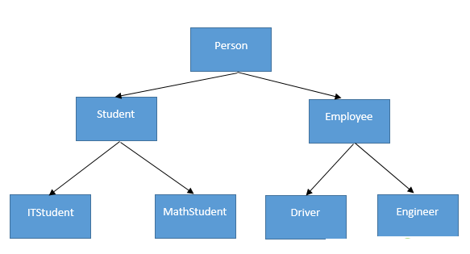

Slide 4
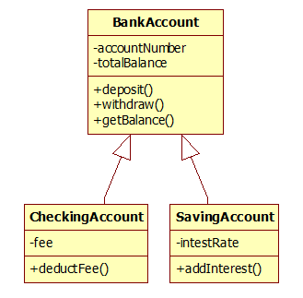

Slide 5
extends Keyword extends is the keyword used to inherit the properties of a class. Following is the syntax of extends keyword. Syntax
class Super
{ ..... ..... }
class Sub extends Super
{ ..... ..... }

Slide 6
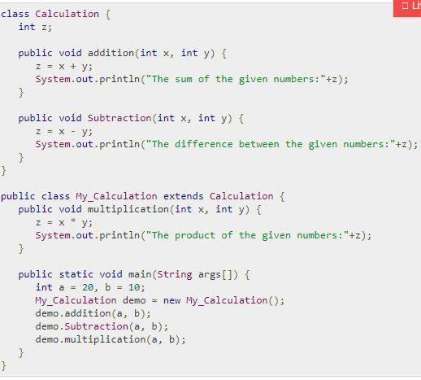

Slide 7
